Slide 1
HOW TO NOT FAIL AT STORM
Kit Menke
Adam Doyle
9/2015

Slide 2
AGENDA
Storm 101
Development
Demo
Testing
Deployment
Implementation

Slide 3

APACHE STORM
HTTP://STORM.APACHE.ORG/
System for processing streaming data in real time
Why would you use it?
  Highly scalable – Amount of data to be processed will increase in the future
  Fault tolerant – Must run 24/7, recover automatically from failures
  Guaranteed processing – Need to process every tuple at least once or exactly once
  “One message at a time” processing paradigm

Slide 4
EXAMPLE USE CASES
Sentiment
Clickstream
Machine/sensors
Logs
Geo-location
Stock trading

Slide 5
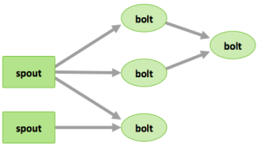
COMPONENTS OF A TOPOLOGY
HTTP://HORTONWORKS.COM/HADOOP/STORM/#SECTION_2
Tuples – an ordered list of elements
Streams – an unbounded sequence of tuples
Spouts – bring data in, create tuples
Bolts – process streams of data
Topologies – network of spouts and bolts

Slide 6
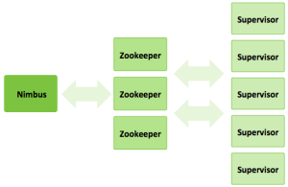
STORM CLUSTER
Nimbus – master node, coordinates storm workers
Supervisors – talks to Nimbus, start/stop workers
Workers – running spouts/bolts
Executors – an instance of a spout/bolt
Notes:
Nimbus is like the “name node” in a normal map reduce cluster.
Supervisors are like the task trackers on each individual node.
Zookeeper for coordination
Worker

Slide 7
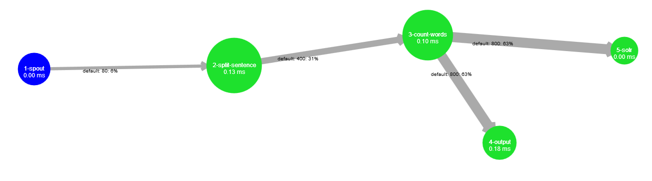
DEVELOPMENT
Set up your DEV Environment: Eclipse, Maven, Git
Use an example to get started: storm-starter
Plan the topology
  One spout per input
  Split bolts in logical units of work
Common problems:
  Managing connections, errors in flow, TickTuples, serialization
Notes:
Setup your environment. Hadoop is very JVM based so the easiest to get started with is Eclipse (for a java topology), Maven, and Git.
Use some example code to get started. Get comfortable with the process of building and deploying.
Tick Tuples – can use to refresh something on a periodic basis

Slide 8
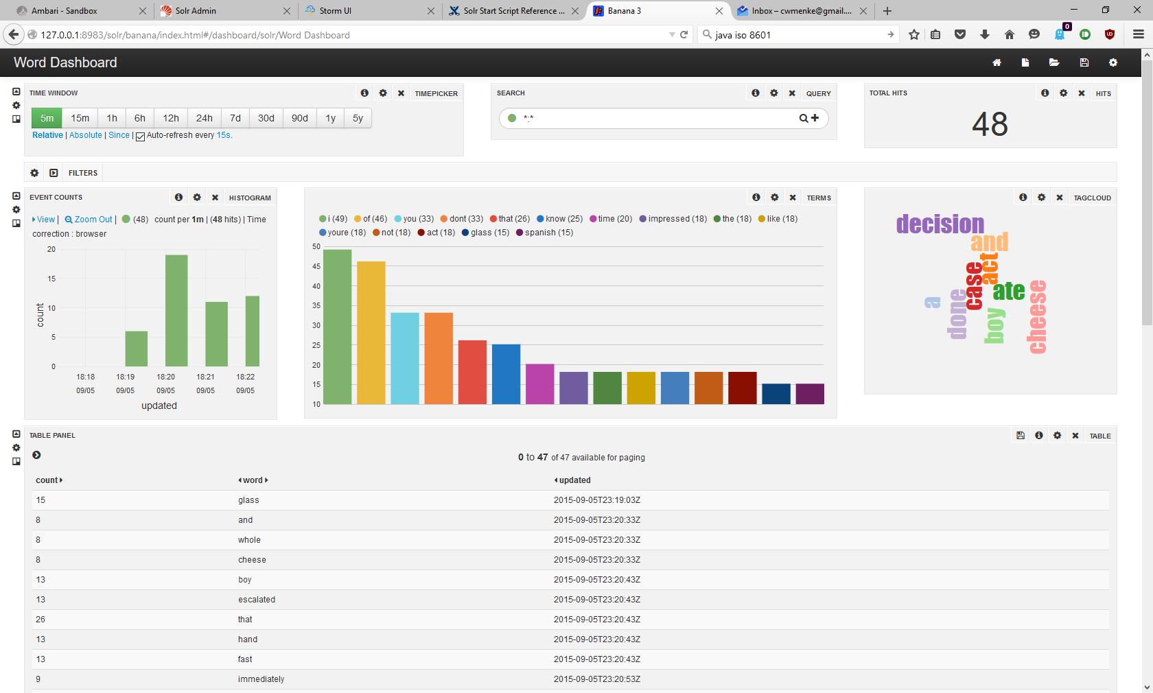
DEMO

Slide 9
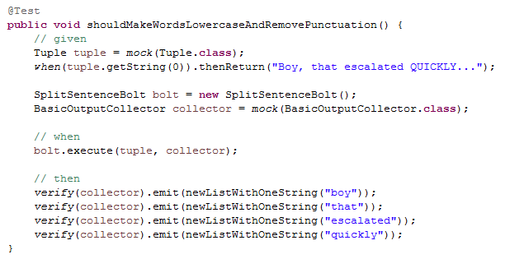
TESTING
Unit Testing
  Depend on unit tests from the start, Mockito is your friend
  Identify logic problems as early as possible
  Find a bug? Create a unit test!
Notes:
Seriously depend on unit tests. Much easier to run a unit test in Eclipse than run through an entire deployment process just to find out there is a bug in your logic.
Integration

Slide 10
TESTING PART 2
Integration Testing
  Connections to HDFS, Hbase, Solr, Relational DB…
  Find: configuration and environment problems
Load Testing
  Complete end to end test with load comparable to PROD
  Find: bolts which need optimization, environment settings to optimize

Slide 11
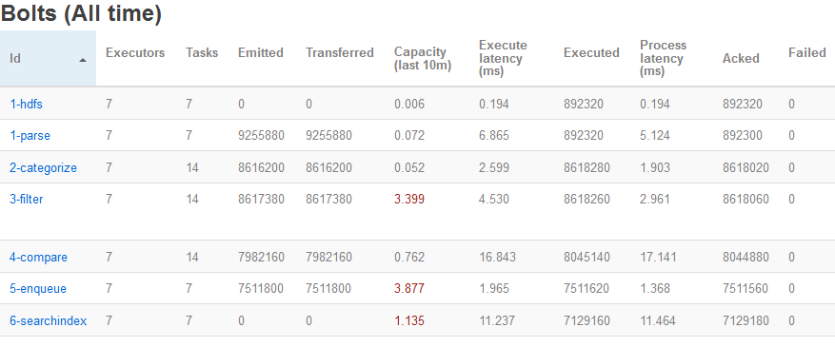
PRODUCTION DEPLOYMENT
Uber-jar packaged up and deployed to cluster
Numbers of Storm nodes/workers/executors/tasks
  Make this configurable
  Based on results from testing
Notes:
Should be based on your testing in DEV

Slide 12
PRODUCTION DEPLOYMENT
Tolerate errors and outages
Updating a topology
  Configuration over code
Increasing load over time
Logging and debugging a running topology
  When Nimbus / supervisor / worker dies…
Common problems:
  Conflicting workloads
  Configuration issues (ex: ULIMIT for storm user)
Notes:
Updates to a topology which is running 24/7
Easier to reload a config periodically than make a code change, rebuild, take an outage to redeploy
Use the Storm UI to identify potential problem areas
Logging in storm is extremely important, log ERRORS to the Storm UI where they are easily visible. Log what else is necessary as INFO using SLF4J
Configuration issues: Ulimits for Storm

Slide 13
RESOURCES
Storm: http://storm.apache.org/
https://github.com/kitmenke/storm-stlhug-demo
http://hortonworks.com/hadoop/storm/
Kit Menke’s Blog (@kitmenke)
  Getting started with Storm: Logging
  Tick tuples within Storm
Adam Doyle (@mypetrock)

Slide 14
QUESTIONS

